Slide 1
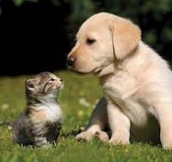
Upcoming
Free Rabies Clinic
Wednesday May 8, 2024
Southside Firehouse
1910 Raritan Road
Scotch Plains, NJ
6:00pm – 7:30pm
All Pets must on a leash or in carriers
And accompanied by an adult
Scotch Plains Health Dept. 908-518-5620
Thursday, November 7, 2024
430 Westfield Ave
Clark, NJ 07066
All Day
All Pets must on a leash or in carriers
Clark Health Dept. 732-428-8405

